Slide 1
Artificial Neural Networks

Slide 2
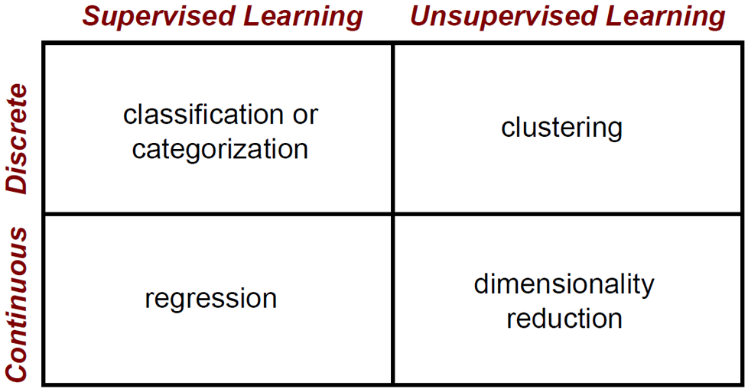
Where are we at?

Slide 3
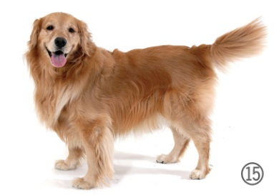
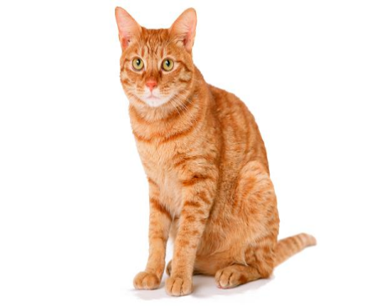
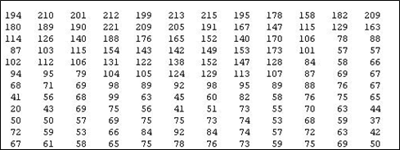
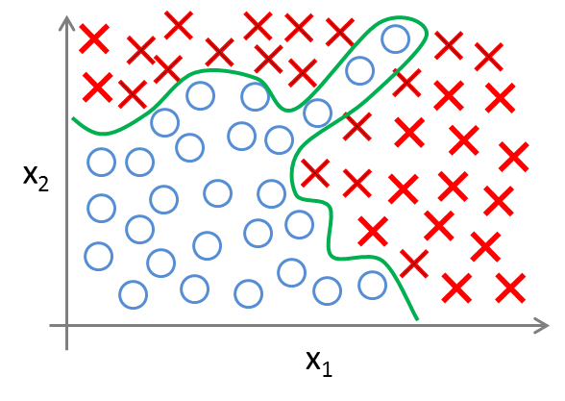
Machine Vision – how hard can it be?
Image recognition is a typical nonlinear classification problem
It seems trivial for humans
Traditional machine learning algorithms used to struggled with it and other types of perceptual problems (speech, etc.)
Logistic regression and many other machine learning algorithms can theoretically find complex nonlinear boundaries but they quickly become computationally untractable in high dimensional spaces for nonlinear classification problems
What we see
What the machine learning algorithm sees
What the machine learning algorithm tries to do

Slide 4


Biological structure and function versus human engineering
The past inability of traditional machine learning algorithms to do well on perceptual tasks motivated the search for biologically inspired answers to the perception problem

Slide 5
Role of bio-inspiration in AI history
Machine learning belongs to the broader field of artificial intelligence (AI)
AI formally established in the 1950s
Initially thoughts: brain is just another type of computer
Confidence about AI soon being able to emulate the brain
No perceived need for bioinspired approaches
Symbolic approach era
AI semi-stuck for several decades (1960s-1990s)
Numerous advances within the same timeframe in neuroscience
Eventually, some concepts from neuroscience percolated into machine learning
Connectionist versus symbolic approach
Implicit versus explicit knowledge representation
Pattern recognition classifiers don’t (yet) match brain performance in many areas (but they are converging in some)

Slide 6
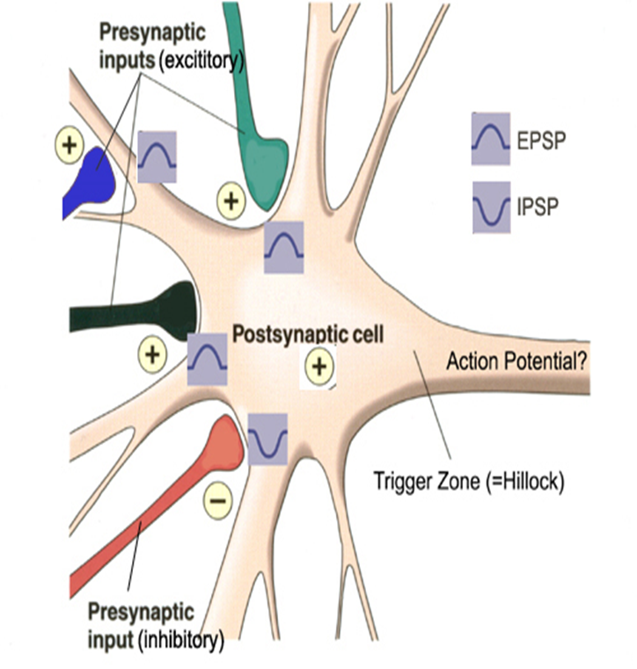

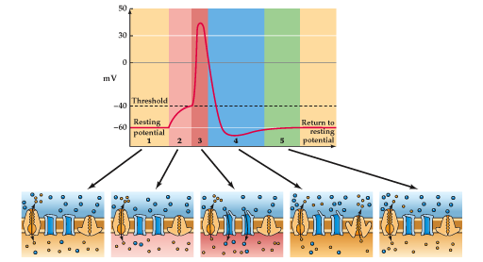
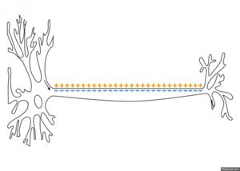
Neurons, Synapses and Action potentials
Notes:
"Blausen 0657 MultipolarNeuron" by BruceBlaus - Own work. Licensed under Creative Commons Attribution 3.0 via Wikimedia Commons - http://commons.wikimedia.org/wiki/File:Blausen_0657_MultipolarNeuron.png#mediaviewer/File:Blausen_0657_MultipolarNeuron.png

Slide 7
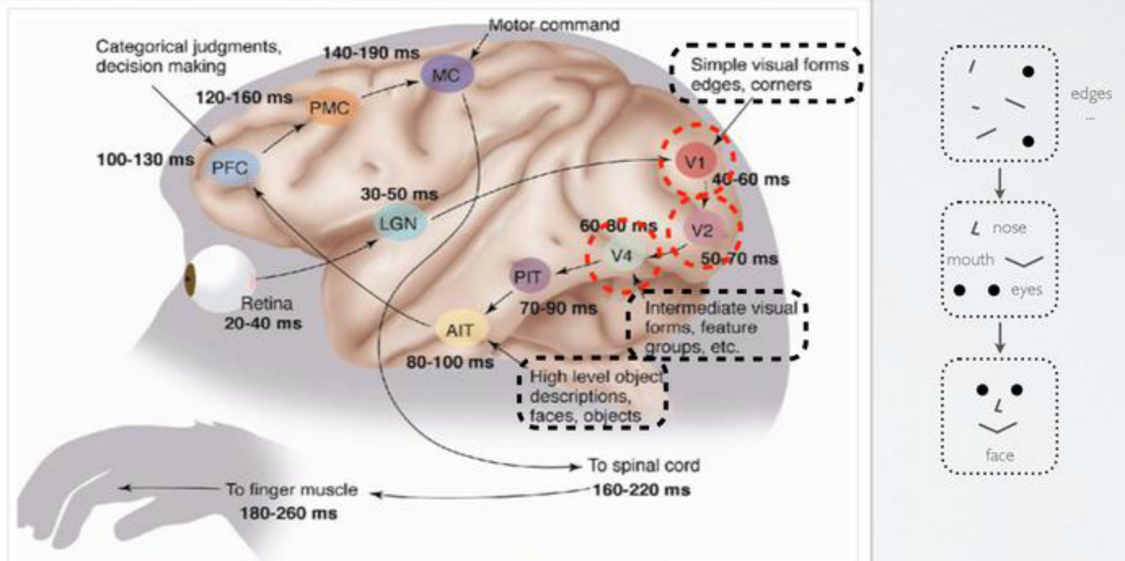
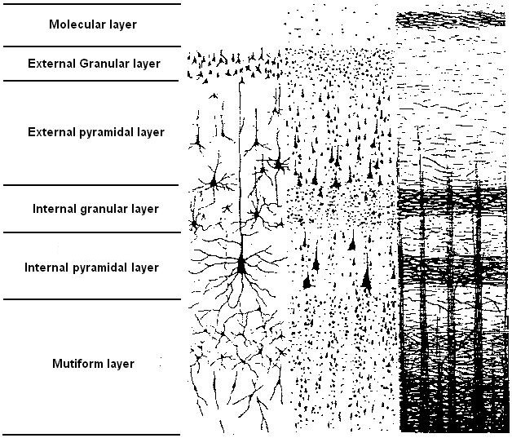
Neocortex characteristics
Most high-level cognitive functions reside in the neocortex
Hierarchical organization
Spatiotemporal coding
Parallel processing
divided in 6 layers
The most complex system in the known universe
Synchronous activity of around 30 billion neurons probably construct who we are
Neocortex is

Slide 8
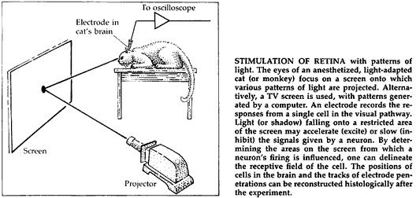

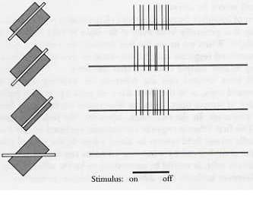
Receptive fields of visual cortex
Notice the strong analogy with lower level features learned by deep neural networks as we will see in future lectures

Slide 9
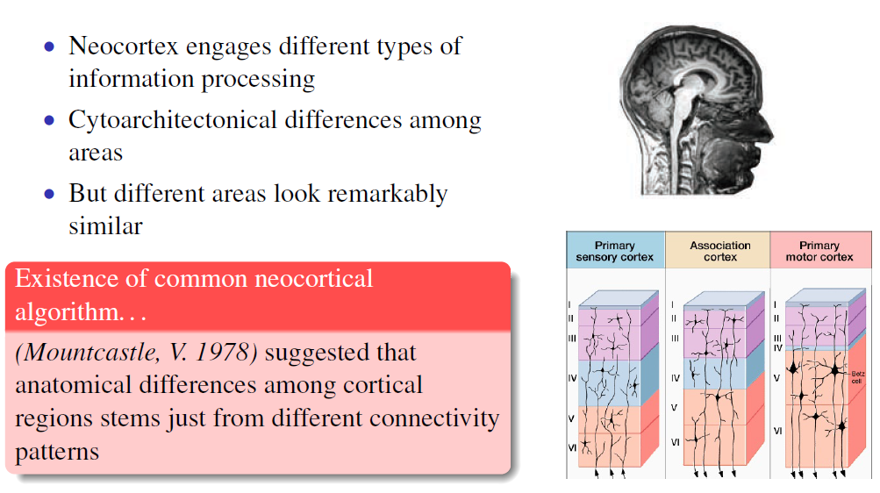
Provocative hypotheses about the neocortex

Slide 10
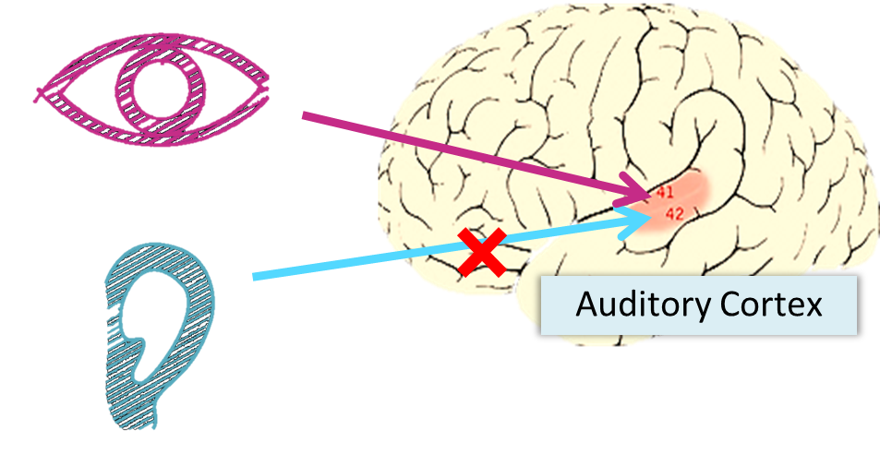
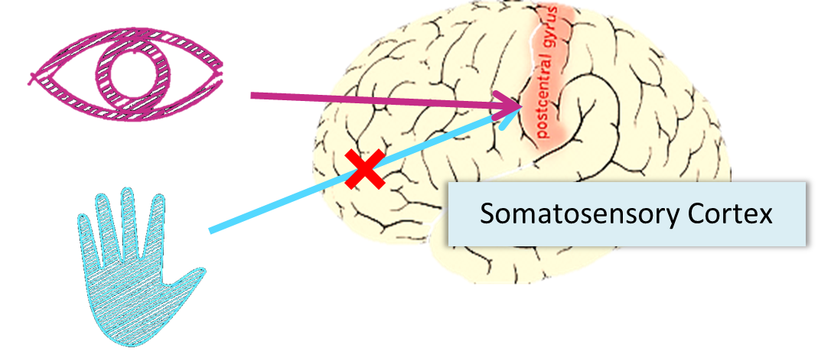
The “one learning algorithm” hypothesis
Auditory cortex learns to see
Somatosensory cortex learns to see

Slide 11
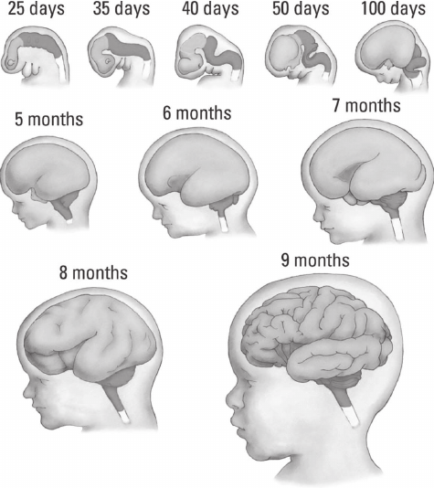
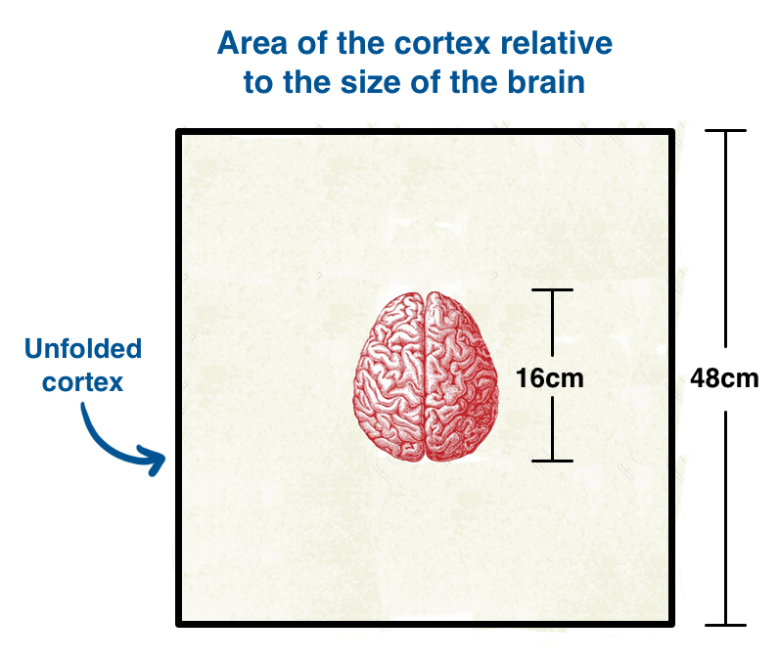
Why Brains Are So Wrinkly? evolutionary trick to maximize computational capacity

Slide 12
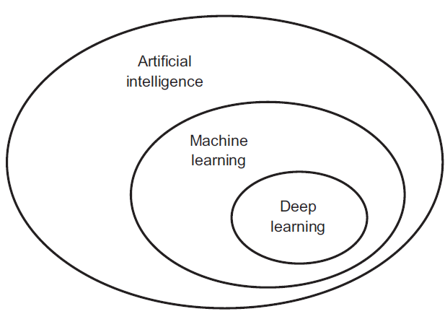
Deep learning

Slide 13

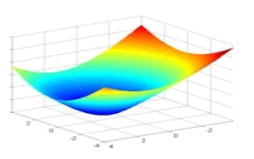
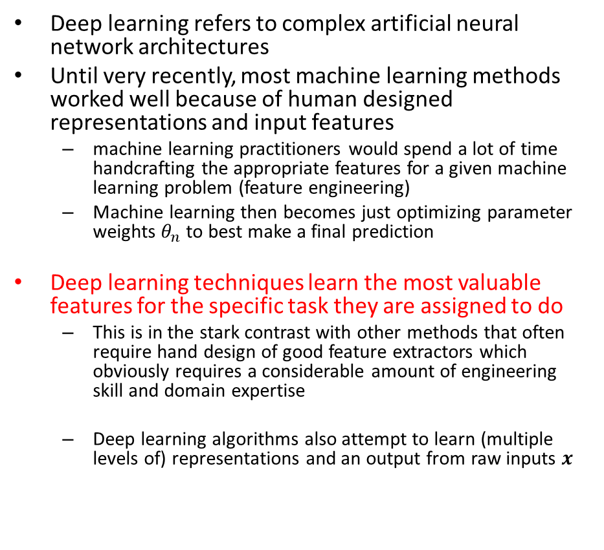
Deep learning Overview
Deep learning refers to complex artificial neural network architectures
Until very recently, most machine learning methods worked well because of human designed representations and input features
machine learning practitioners would spend a lot of time handcrafting the appropriate features for a given machine learning problem (feature engineering)
Machine learning then becomes just optimizing parameter weights $θ_{n}$ to best make a final prediction
Deep learning techniques learn the most valuable features for the specific task they are assigned to do
This is in the stark contrast with other methods that often require hand design of good feature extractors which obviously requires a considerable amount of engineering skill and domain expertise
Deep learning algorithms also attempt to learn (multiple levels of) representations and an output from raw inputs $x$

Slide 14
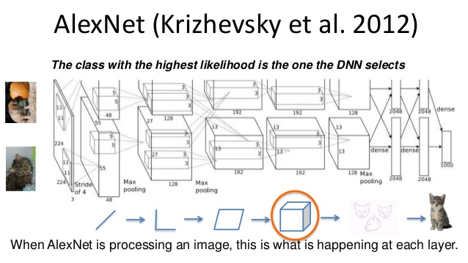
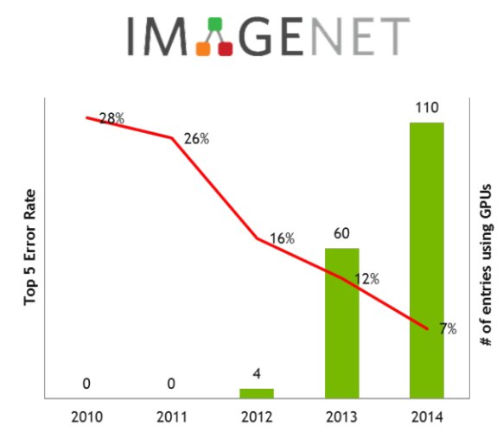
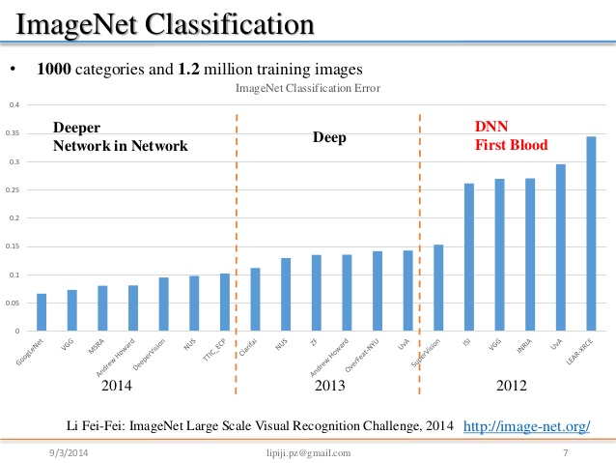
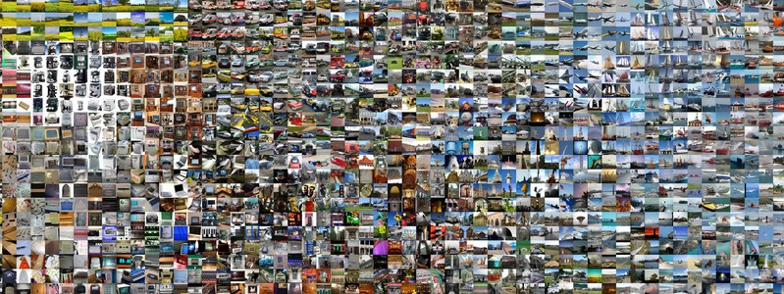
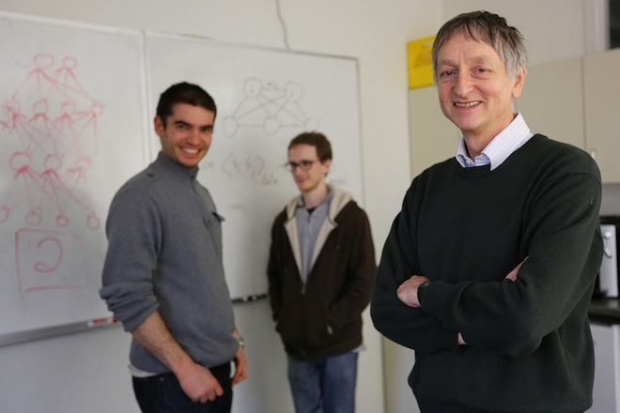
Historical Deep learning breakthrough for computer vision
The breakthrough DL paper: ImageNet Classification with Deep Convolutional Neural Networks by Krizhevsky, Sutskever, & Hinton, 2012, U. Toronto. 37% error red.
Many further successes in machine translation, NLP, etc.

Slide 15
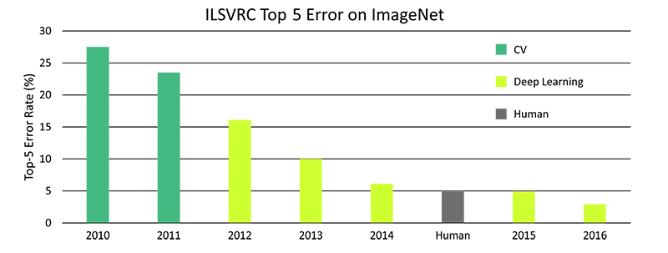

Deep learning fast progress

Slide 16
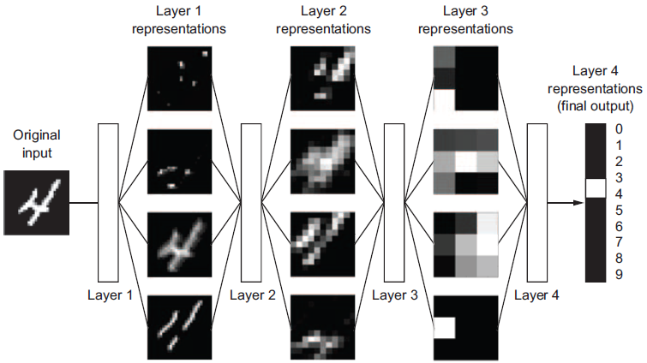
The “deep” in deep learning
The "deep" in "deep learning" is not a reference to any kind of "deeper" understanding achieved by the approach, rather, it simply stands for this idea of successive layers of representations that encode the statistical structure of the input
How many layers contribute to a model of the data is called the "depth" of the model
Increasingly complex representations are developed layer-by-layer
Other appropriate names for the field could have been "layered representations learning" or "hierarchical representations learning".

Slide 17
What has deep learning achieved so far
Although deep learning is a fairly old subfield of machine learning, it only rose to prominence in the early 2010s.
In the few years since, it has achieved nothing short of a revolution in the field, with remarkable results on perceptual problems such as seeing and hearing—problems involving skills that seem natural and intuitive to humans but have long been elusive for machines.
In particular, deep learning has achieved the following breakthroughs, all in historically difficult areas of machine learning:
human-level image classification
Near-human-level speech recognition
human-level handwriting transcription
Improved machine translation
Improved text-to-speech conversion
Digital assistants such as Google Now and Amazon Alexa
Near-human-level autonomous driving
Improved ad targeting, as used by Google, Baidu, and Bing
Improved search results on the web
Ability to answer natural-language questions
Superhuman Go playing

Slide 18

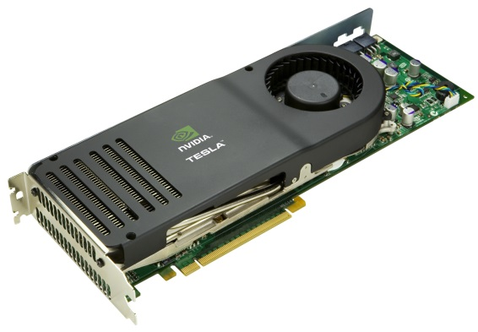
Why deep learning techniques work so well?
3. New models, algorithms, ideas
1. Data
2. Hardware improvements
Better activation functions for neural layers
Better weight-initialization schemes
Better optimization schemes, such as RMSProp and Adam
Better, learning of intermediate representations
Effective end to end joint system learning
Effective learning methods for using contexts and transferring between tasks
Deep models only shine when you have enough data to train them!
Vectorized computations on GPUs markedly outperform CPUs

Slide 19
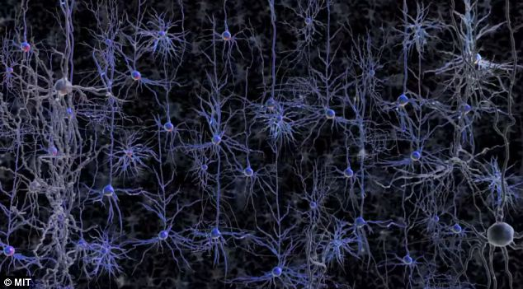
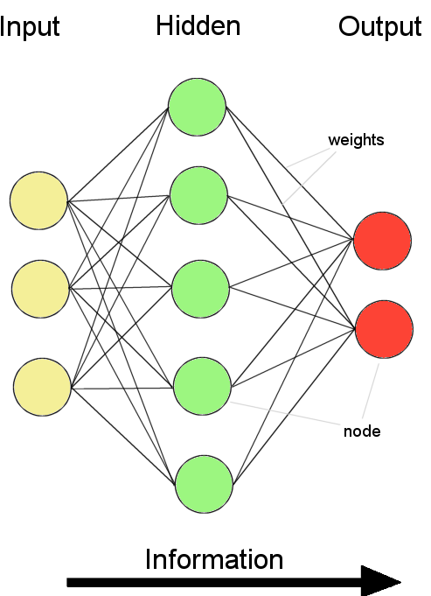
Deep learning used to be called Artificial neural networks
Biological analogy of deep learning
Biological neural learning happens by the modification of the synaptic strength
Artificial Neural Networks (ANN)
ANN is composed of a system of “neurons” (computational nodes) connected by “synapses” (edges/weights)
Basically, logistic regression units
Adjust synaptic connections between neurons to improve performance on an objective function J
The synapse strength modification rules for artificial neural networks can be derived by applying mathematical optimisation methods
The biological analogy of an ANN as similar to a biological neural network is probably an overstretch (soft of like comparing the wings of an airplane to the wings of a bird)

Slide 20
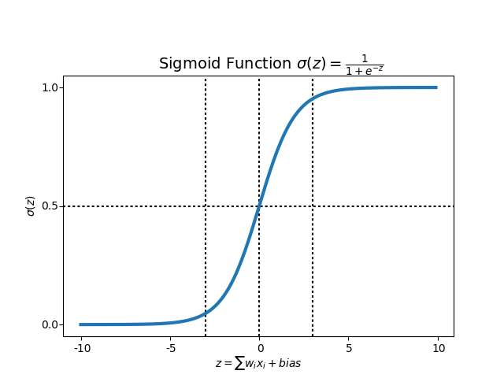
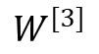
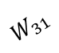
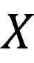
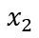
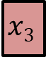
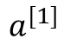
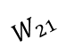
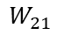
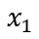
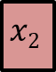
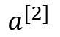
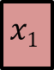
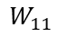
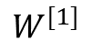
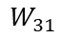
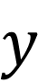
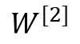
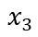
Artificial neural networks: computational architecture overview
$$y$$
$$X$$
$$a^{[1]}$$
$$W^{[1]}$$
$$W^{[2]}$$
$$a^{[2]}$$
$$W^{[3]}$$
$$x1$$
$$x2$$
$$x3$$
$$W_{11}$$
$$W_{21}$$
$$W_{31}$$
Activation function
Activation function
Activation function
$$W_{11}$$
$$x_{1}$$
$$W_{21}$$
$$W_{31}$$
$$x_{2}$$
$$x_{3}$$
Input layer
Hidden layer 1
Hidden layer 2
Output layer

Slide 21







Network computational units: basically, logistic regression
$$X$$
$$y$$
$$x1$$
$$x2$$
$$x3$$
f is a nonlinear activation function

Slide 22


























The nonlinear activation function $g$
rectifier neural unit (reLU ()
$$a$$
The activation function of each neuron unit is generally non-linear.
Linear functions are limited because the output is simply proportional to the input.
$$a=g\left(z\right)=max⁡(0,z)$$
$$z$$
$$x=\left[\begin{matrix}x1 \\ x2 \\ x3\end{matrix}\right]$$
$$W=θ=\left[\begin{matrix}θ1 \\ θ2 \\ θ3\end{matrix}\right]$$
sigmoid
$$a$$
$$a=g\left(z\right)=\frac{1}{1+e^{−z}}$$
$$z=x∙θ=\sum_{i=1}^{n−1}{θ_{i}x_{i}}=θ_{1}x_{1}+θ_{2}x_{2}+θ_{2}x_{2}$$
$$a=g\left(z\right)=g(\sum_{i=1}^{n−1}{θ_{i}x_{i}})$$
$$z$$
$$θ1$$
Hyperbolic tangent
$$θ2$$
$$a$$
$$a=g\left(z\right)=\frac{e^{z}−e^{−z}}{e^{z}+e^{−z}}$$
$$z$$
$$a=g(z)$$
$$a$$
$$θ3$$
$$z$$

Slide 23


















$$g(z)$$
Simple computations with single units: AND
$$a=x_{1}AND x_{2}$$
$$θ1=−30$$
$$θ2=20$$
$$z$$
$$g(z)$$
$$g(x_{1},x_{2})≈x1 AND x2$$
0 | 0
0 | 1
1 | 0
1 | 1
$$θ3=20$$
$$g(−30)≈0$$
$$g(−10)≈0$$
$$g(−10)≈0$$
$$a=g(−30+20x1+20x2)$$
$g(10)≈$ 1

Slide 24





$$g(z)$$
Simple computations with single units: AND
$$a=y=x_{1}OR x_{2}$$
$$θ1=−10$$
$$θ2=20$$
$$z$$
$$g(z)$$
$$g(x_{1},x_{2})≈x1 OR x2$$
0 | 0
0 | 1
1 | 0
1 | 1
$$θ3=20$$
$$g(−30)≈0$$
$$g(−10)≈0$$
$$g(−10)≈0$$
$$a=g(−10+20x1+20x2)$$
$g(10)≈$ 1

Slide 25

















Why are nonlinearities functions needed?
Without nonlinearities, deep neural networks can’t do anything more than a linear transformation
Extra layers could just be compiled down into a single linear transform:
$W3W2W1x=Wx$
With nonlinearities, deep neural networks can find nonlinear decision boundaries
$$y=W_{4}∙W_{3}∙W_{2}{∙W}_{1}∙x$$
$$y={softmax(W}_{4}∙{g(W}_{3}∙{g(W}_{2}{∙g(W}_{1}∙x))))$$
$$x$$
$$W_{1}$$
$$a_{1}$$
$$W_{2}$$
$$a_{2}$$
$$W_{3}$$
$$a_{3}$$
$$W_{4}$$
$$y$$
Notice that a neural network is just a long chain of functions!
$$a_{1}=g(W_{1}x)$$
$$a_{2}=g(W_{2}a_{1})$$
$$a_{3}=g(W_{3}a_{2})$$
$$y=softmax(W_{4}a_{3})$$
Notes:
This trick, makes the math very simple.
It takes the advantages of linear models
While simultaneously making the model more flexible and powerful by making it not linear

Slide 26







Recap about Image classification
MNIST images
We can flatten this array into a vector of 28x28 = 784 numbers. It doesn't matter how we flatten the array, as long as we're consistent between images. From this perspective, the MNIST images are just a bunch of points in a 784-dimensional vector space
Each image in MNIST has a corresponding label, a number between 0 and 9 representing the digit in the image. We can code labels as "one-hot vectors“: a vector which is 0 in most dimensions, and 1 in a single dimension. In this case, the nth digit will be represented as a vector which is 1 in the nth dimension. For example, 3 would be [0,0,0,1,0,0,0,0,0,0].
$$y$$
$$X$$

Slide 27

Flattening an RGB image

Slide 28




The softmax
Softmax is a special activation function for the last layer of an artificial neural network
Softmax is a generalization (up to as many classes as the task specifies) of sigmoid.
The sigmoid function is a special case of the softmax where the number of class equals to 2.
The softmax is used in the last layer of a neural network to output an n size vector with the probabilities of class membership
It transforms logits/scores/z from an infinite range into probabilities of class membership
Softmax has 2 steps:
Add up the evidence of our input being in certain classes
Convert that evidence into probabilities
$$P(y=0|X^{(i)})$$
$$P(y=1|X^{(i)})$$
z/Evidence/scores/logits
z=W_{i}x

Slide 29














The labels in our training data $y$and the output predictions of our model $\hat{y}$
$$\hat{y}$$
$$\hat{y}=g(W\left(x\right))∈ℝ4$$
$$x$$
$$X=\left[\begin{matrix}x11 \\ x21 \\ \begin{aligned}⋮ \\ xr1\end{aligned}\end{matrix} \begin{matrix}\begin{aligned}x12 \\ x22\end{aligned} \\ ⋮ \\ xr2\end{matrix} \begin{matrix}\begin{aligned}… \\ …\end{aligned} \\ … \\ …\end{matrix} \begin{matrix}\begin{aligned}x1c \\ x2c\end{aligned} \\ ⋮ \\ xrc\end{matrix}\right]$$
$$y=\left[\begin{matrix}y1 \\ y2 \\ \begin{aligned}⋮ \\ yr\end{aligned}\end{matrix} \right]$$
$$\left[\begin{matrix}0.6 \\ 0.1 \\ \begin{matrix}0.2 \\ 0.1\end{matrix}\end{matrix}\right]$$
Example Output prediction of the network
Labels in training data: ground truth
$$y=hW(x)≈\left[\begin{matrix}0 \\ 0 \\ \begin{matrix}0 \\ 1\end{matrix}\end{matrix}\right]$$
$$y=hW(x)≈\left[\begin{matrix}1 \\ 0 \\ \begin{matrix}0 \\ 0\end{matrix}\end{matrix}\right]$$
$$y=hW(x)≈\left[\begin{matrix}0 \\ 1 \\ \begin{matrix}0 \\ 0\end{matrix}\end{matrix}\right]$$
$$y=hW(x)≈\left[\begin{matrix}0 \\ 0 \\ \begin{matrix}1 \\ 0\end{matrix}\end{matrix}\right]$$
dog
cat
horse
mouse

Slide 30




We can now measure of how well our model is doing by comparing 2 vectors:
one coming out of the classifier and containing the probabilities of each class $\hat{y}$
The one hot encoded vector that corresponds to your labels $y$
$$\hat{y}predictions$$
$$y$$

Slide 31





Loss/Cost function: Cross entropy
The natural way to measure the distance between those 2 probability vectors is called the cross entropy (a measurement of distance between vectors )
$$y=log⁡(x)$$
$$\hat{y}predictions$$
$$y$$

Slide 32


Feed forward and Backpropagation steps
Feed forward is calculating the output of the network ${\hat{y}}^{(n)}$based on the input $x^{(n)}$
The Back propagation algorithm tries to change the weights of the connections in the network in order to optimize the performance of the network for a particular task ( basically gradient descent applied to neural networks)

Slide 33








Cost/Loss function: Minimize average cross entropy
Remember that we are trying to find those weights W and biases b that make the model have a low cross entropy loss (J) for correctly classify instances ($\hat{y}$ close to $y$) and high cross entropy loss for incorrectly classified instances
$$ypredictions$$
$$J(W_{1},W_{2})$$
$$y$$
$$W_{1}$$
$$W_{2}$$

Slide 34

Recommended resources
TensorFlow Playground

